Slide 1
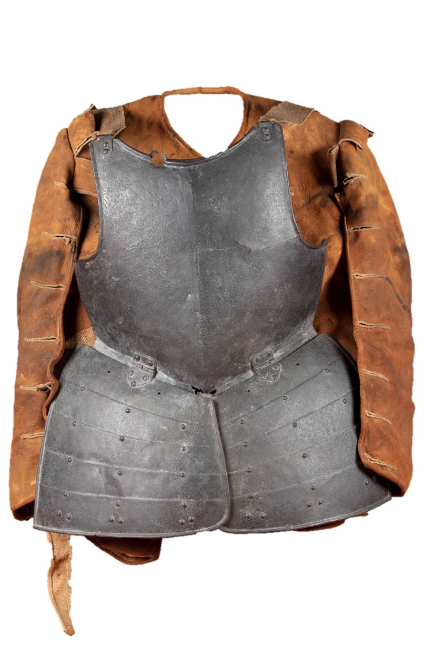



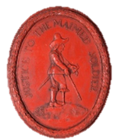
Fight a battle
Find a battlefield
Solve a mystery
Meet some soldiers
Soldiers

Slide 2



What happened to
John Hussey?
Soldiers

Slide 3
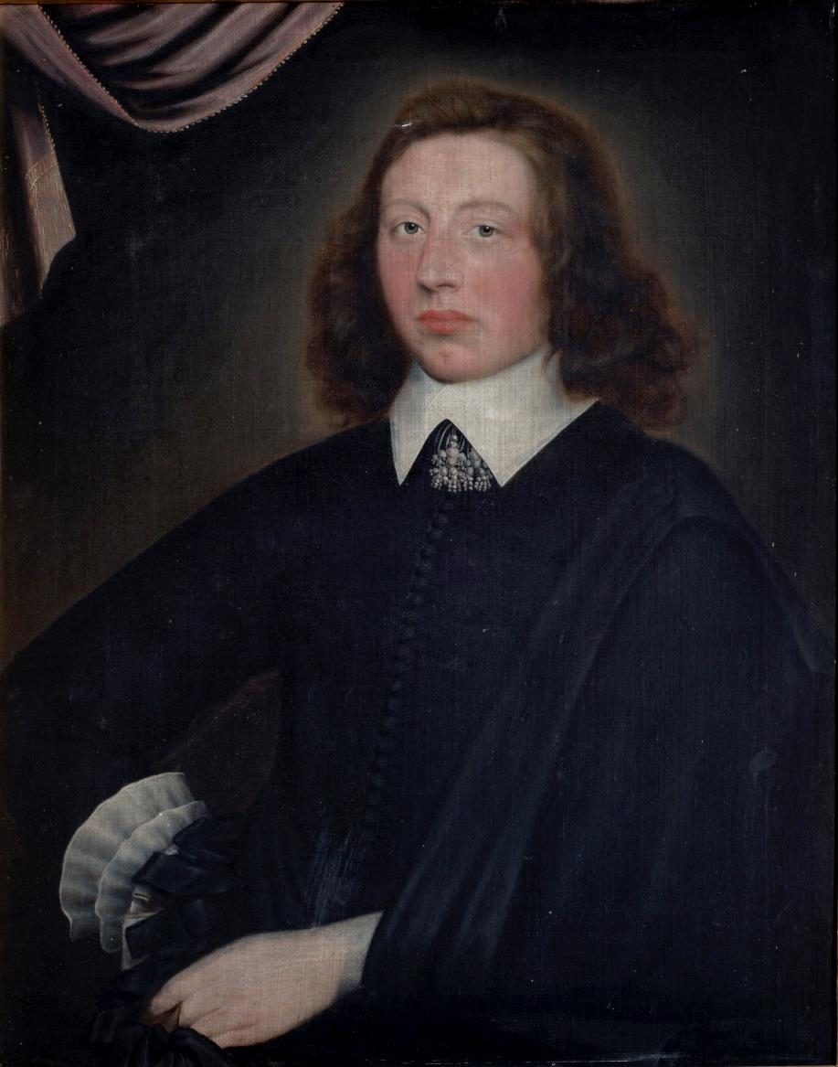
Who was John Hussey?
John Hussey was born in about 1615. He was the second son of Sir Edward Hussey.
He had three brothers (Thomas, Charles and Edward) and 5 sisters ( Jane, Mary, Rebecca, Bridget and Anne)
His father, Sir Edward Hussey, was an important man. He had been High Sheriff of Lincolnshire in 1618. This meant he was in charge of law and order in the county.

Slide 4
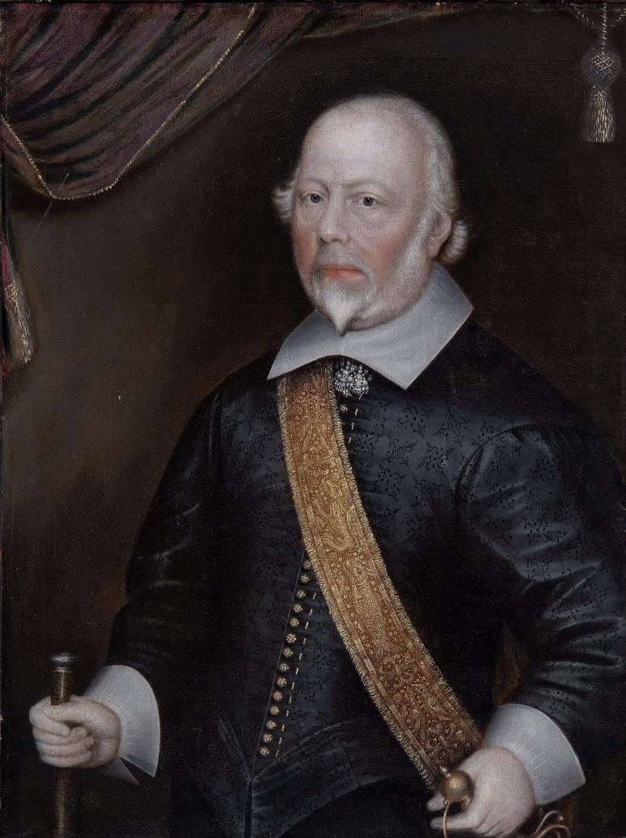
Sir Edward Hussey
Sir Edward Hussey was John’s father.
In 1611 Sir Edward Hussey had raised an infantry regiment for the King that fought in Ireland.
Sir Edward Hussey was a Royalist.
He helped to raise troops for the king and even provided some horses.
He fought at the King’s important garrison at Newark, in Nottinghamshire.

Slide 5
John Hussey’s death.
Like his father, John Hussey fought for the King.
He was the Captain of a Royalist cavalry regiment.
He fought at the battle of Gainsborough in 1643.
He was killed in this battle on 28 July 1643.

Slide 6

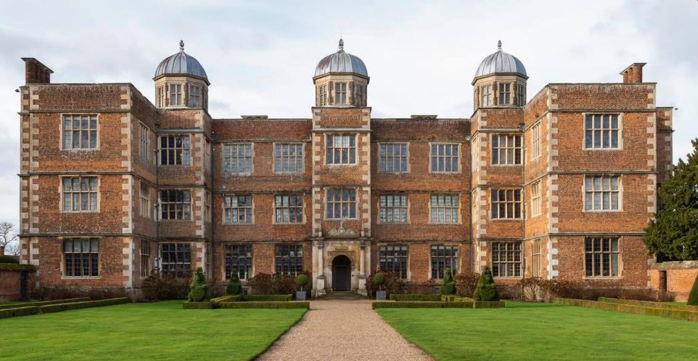
John Hussey’s Armour
The armour that John Hussey wore into battle survives.
.
The Hussey family moved from Honington, near Grantham, to Doddington Hall where John Hussey’s armour is now on display.

Slide 7
What happened to John Hussey?
Click the pictures below to look at the different parts of John Hussey’s armour.
What do you think happened to him?
.

Slide 8

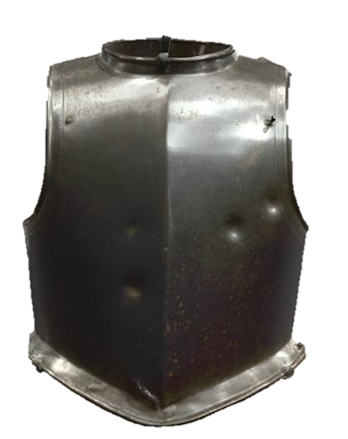
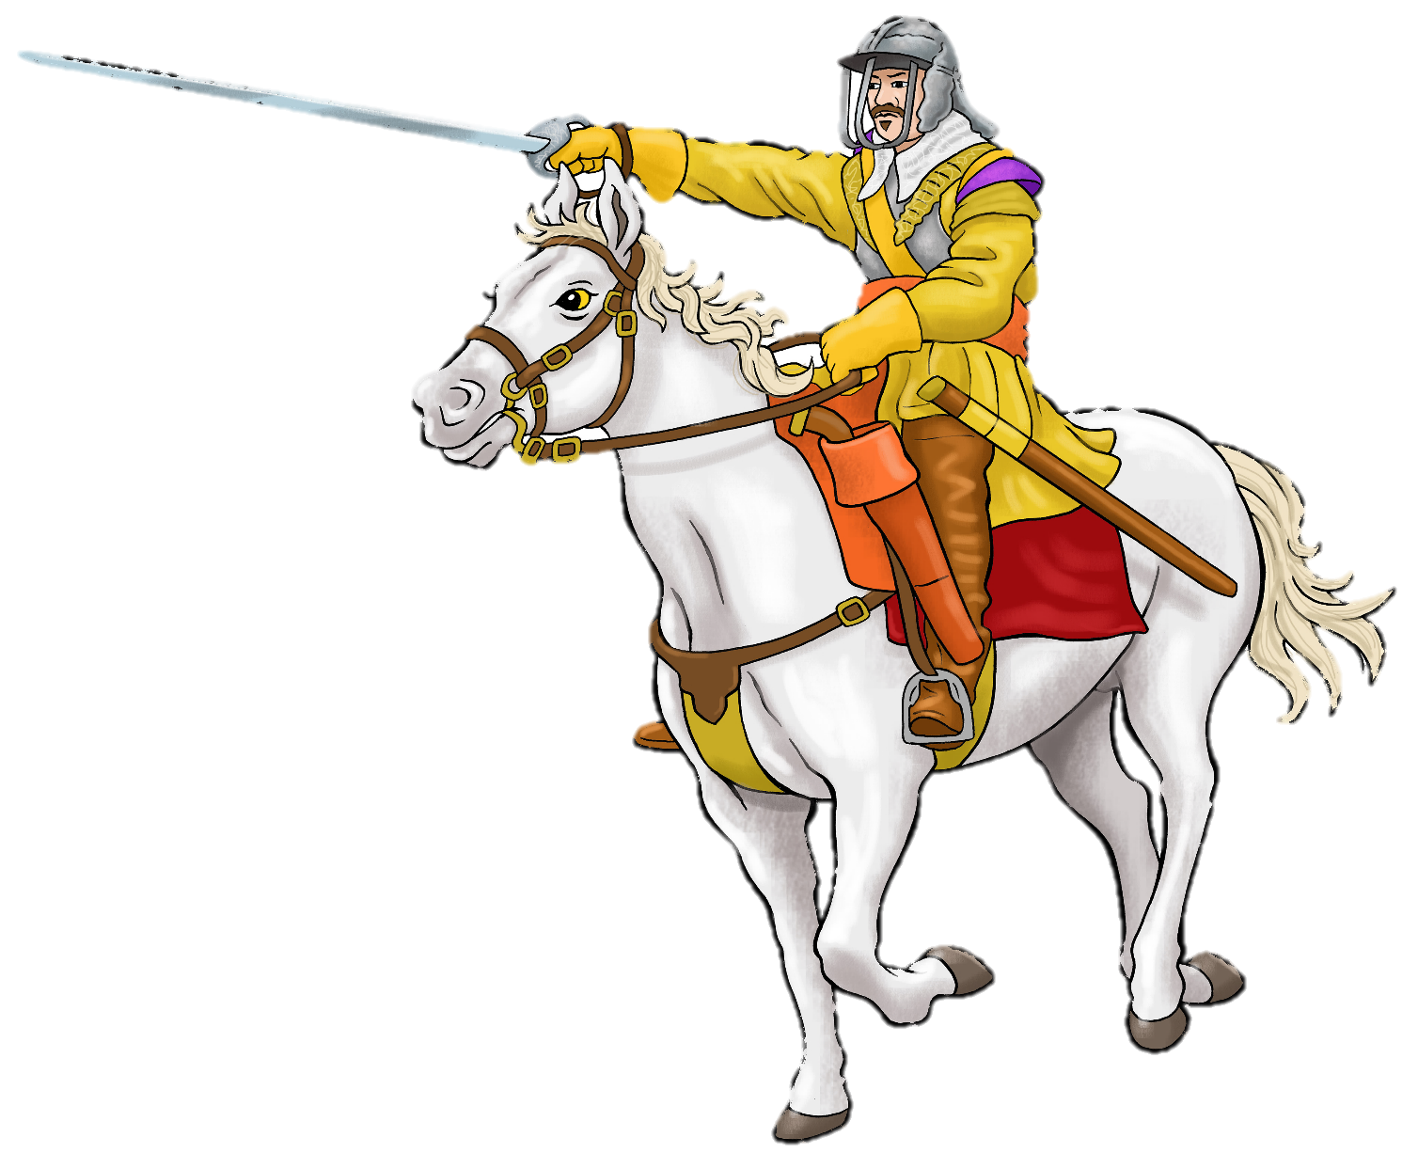
What are the differences between Hussey’s amour and the usual cavalry amour?
Click here to look closely at this object
Hussey’s amour

Slide 9
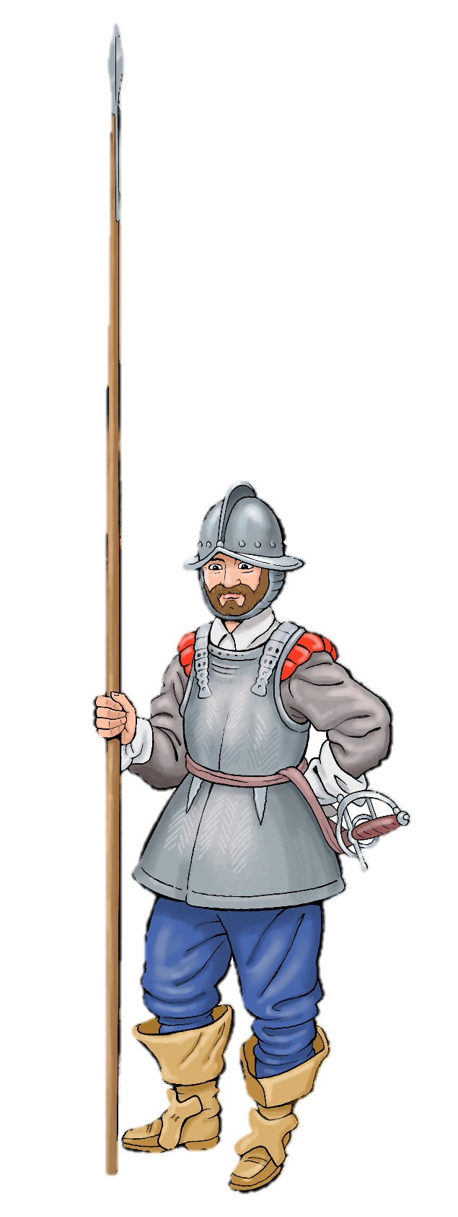
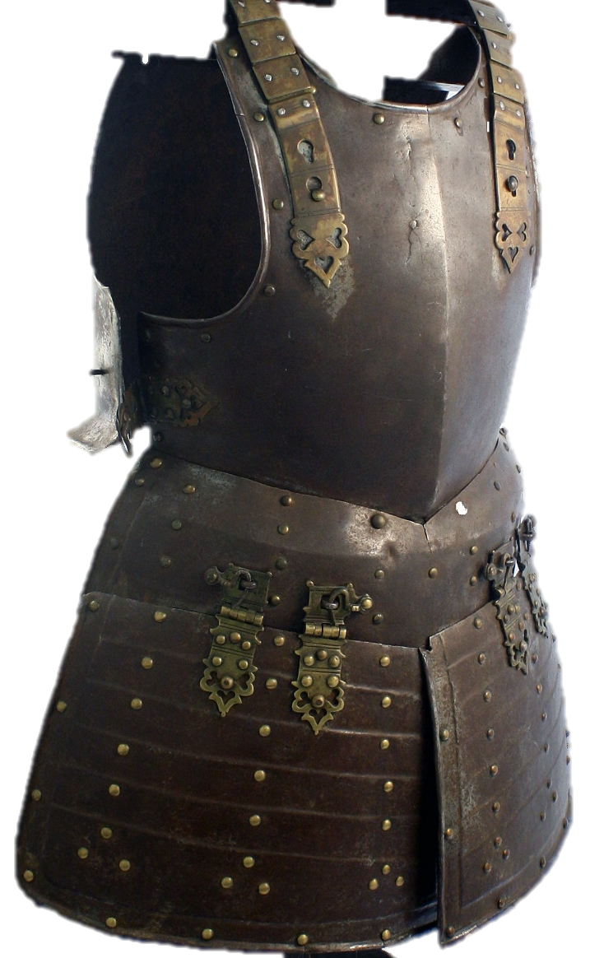
What kind of soldier have you seen wearing this kind of armour before?
Hussey’s amour

Slide 10
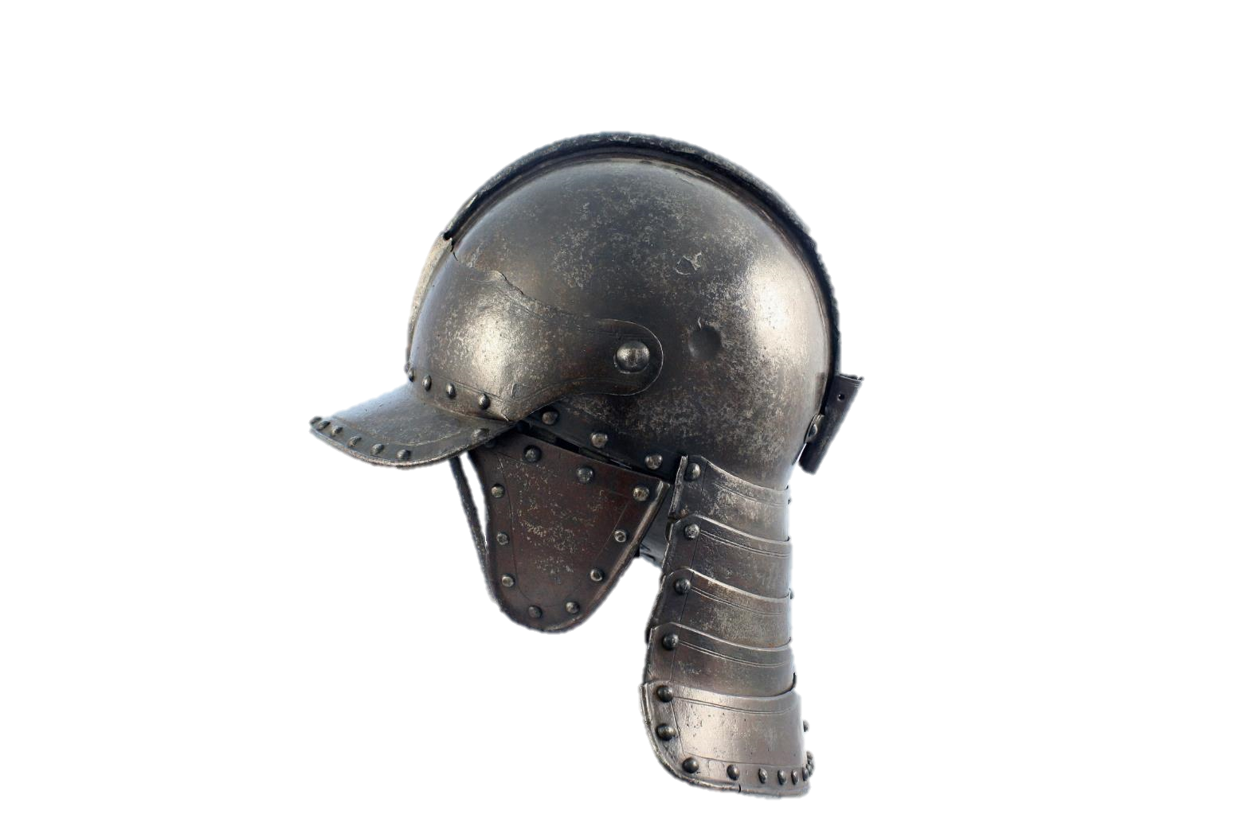
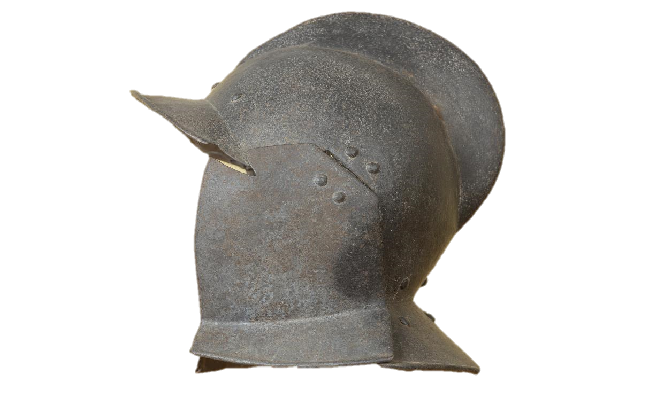
What are the differences between Hussey’s helmet and the usual cavalry helmet?
Which of these helmets do you think would be
the best to wear in a battle? Why?
Hussey’s helmet
Civil War Cavalry helmet

Slide 11
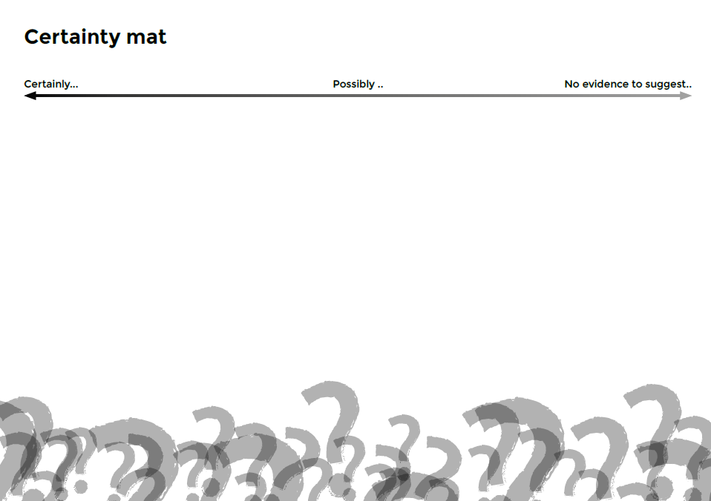
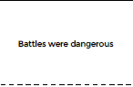
What can we learn from John Hussey’s armour ?
This armour can tell us about Hussey’s death.
It can also give us clues about the challenges of fighting a civil war.
Cut up the statement cards and place them onto the mat to show what this armour can certainly or possibly tell us.

